Slide 1
Loan Admin Management Application
CAPSTONE PROJECT
LAMA

Slide 2
The Application
LAMA provides a facility for GIS Global Employees to purchase items from GIS Global Mart and facilitates a flexible loan to purchase the items. GIS Global issues loan cards for various purchases like furniture, stationary, crockery, etc., to all their employees. Each employee can be issued with different types of cards for purchasing diff categories of products.

Slide 3
Use Cases
01
02
03
04
Allow the admin to login using valid credentials.
Admin can maintain the customer data.
Admin manages loan cards ie, add or delete or update loan cards.
05
Admin maintains the item master data.
Admin adds loan cards or deletes loan cards for the customers.

Slide 4





Tool Chain
MySQL
React
Spring Boot
Spring JPA
GIT
Maven
Database
Presentation layer
Backend processing
Database Connectivity
Version control systems
Build Tools

Slide 5
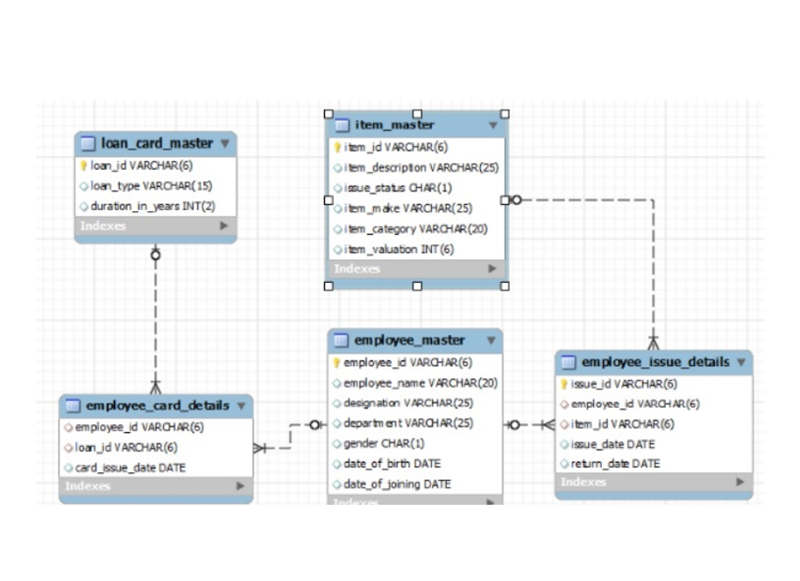
Database Schema

Slide 6
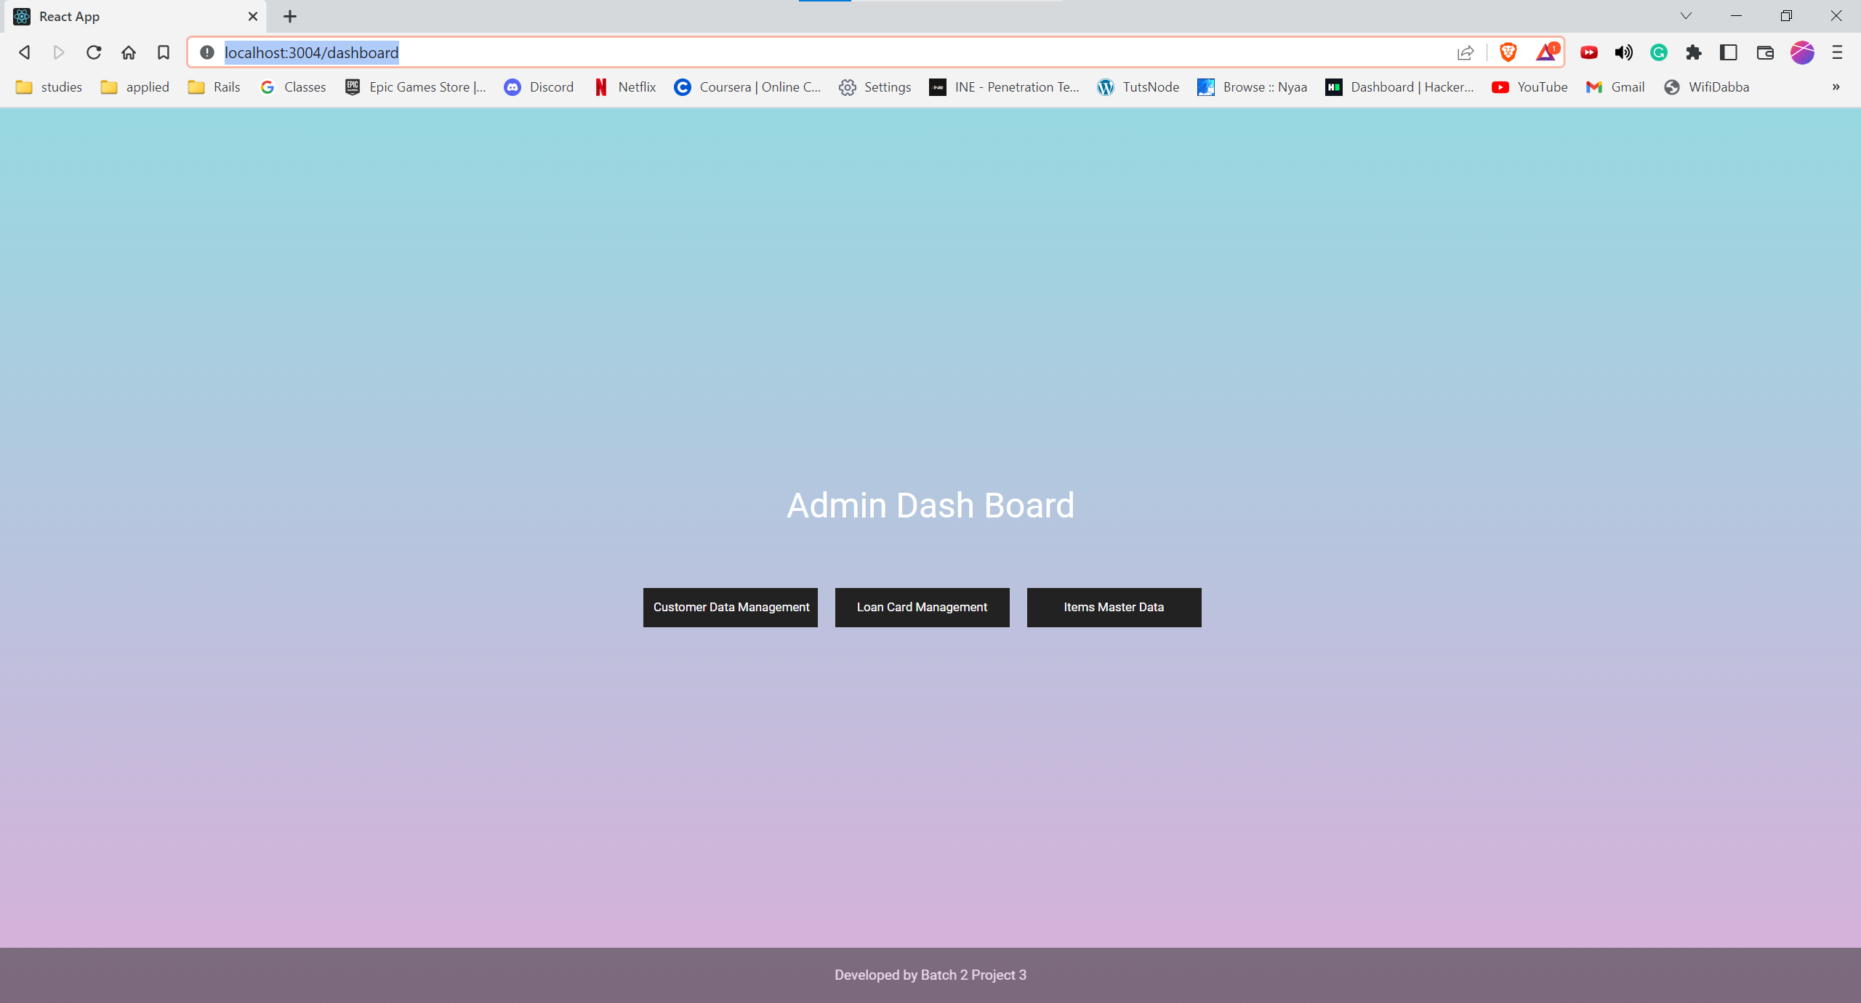
Dashboard

Slide 7
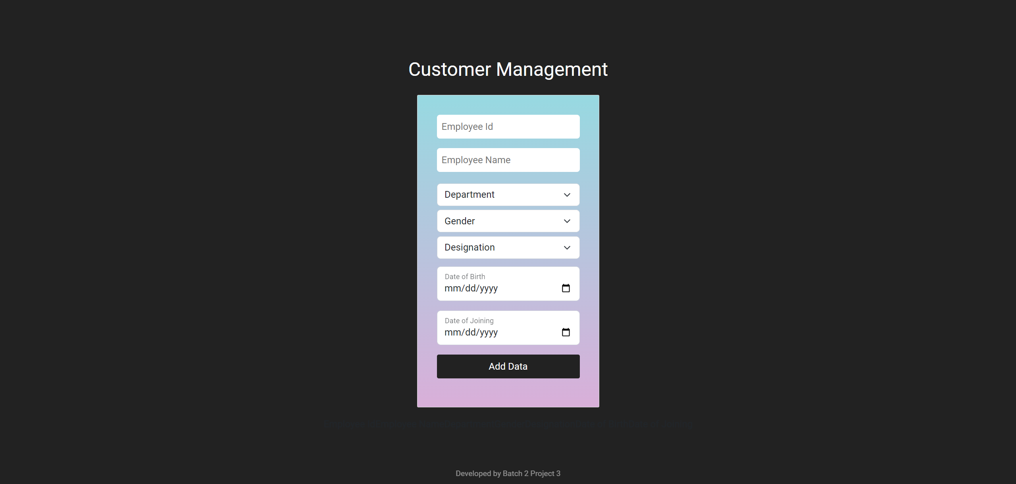
Customer Management

Slide 8
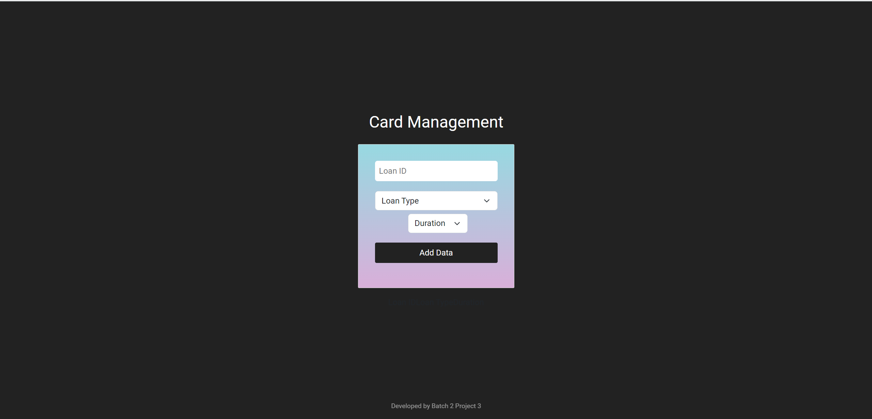
Loan Card Management

Slide 9
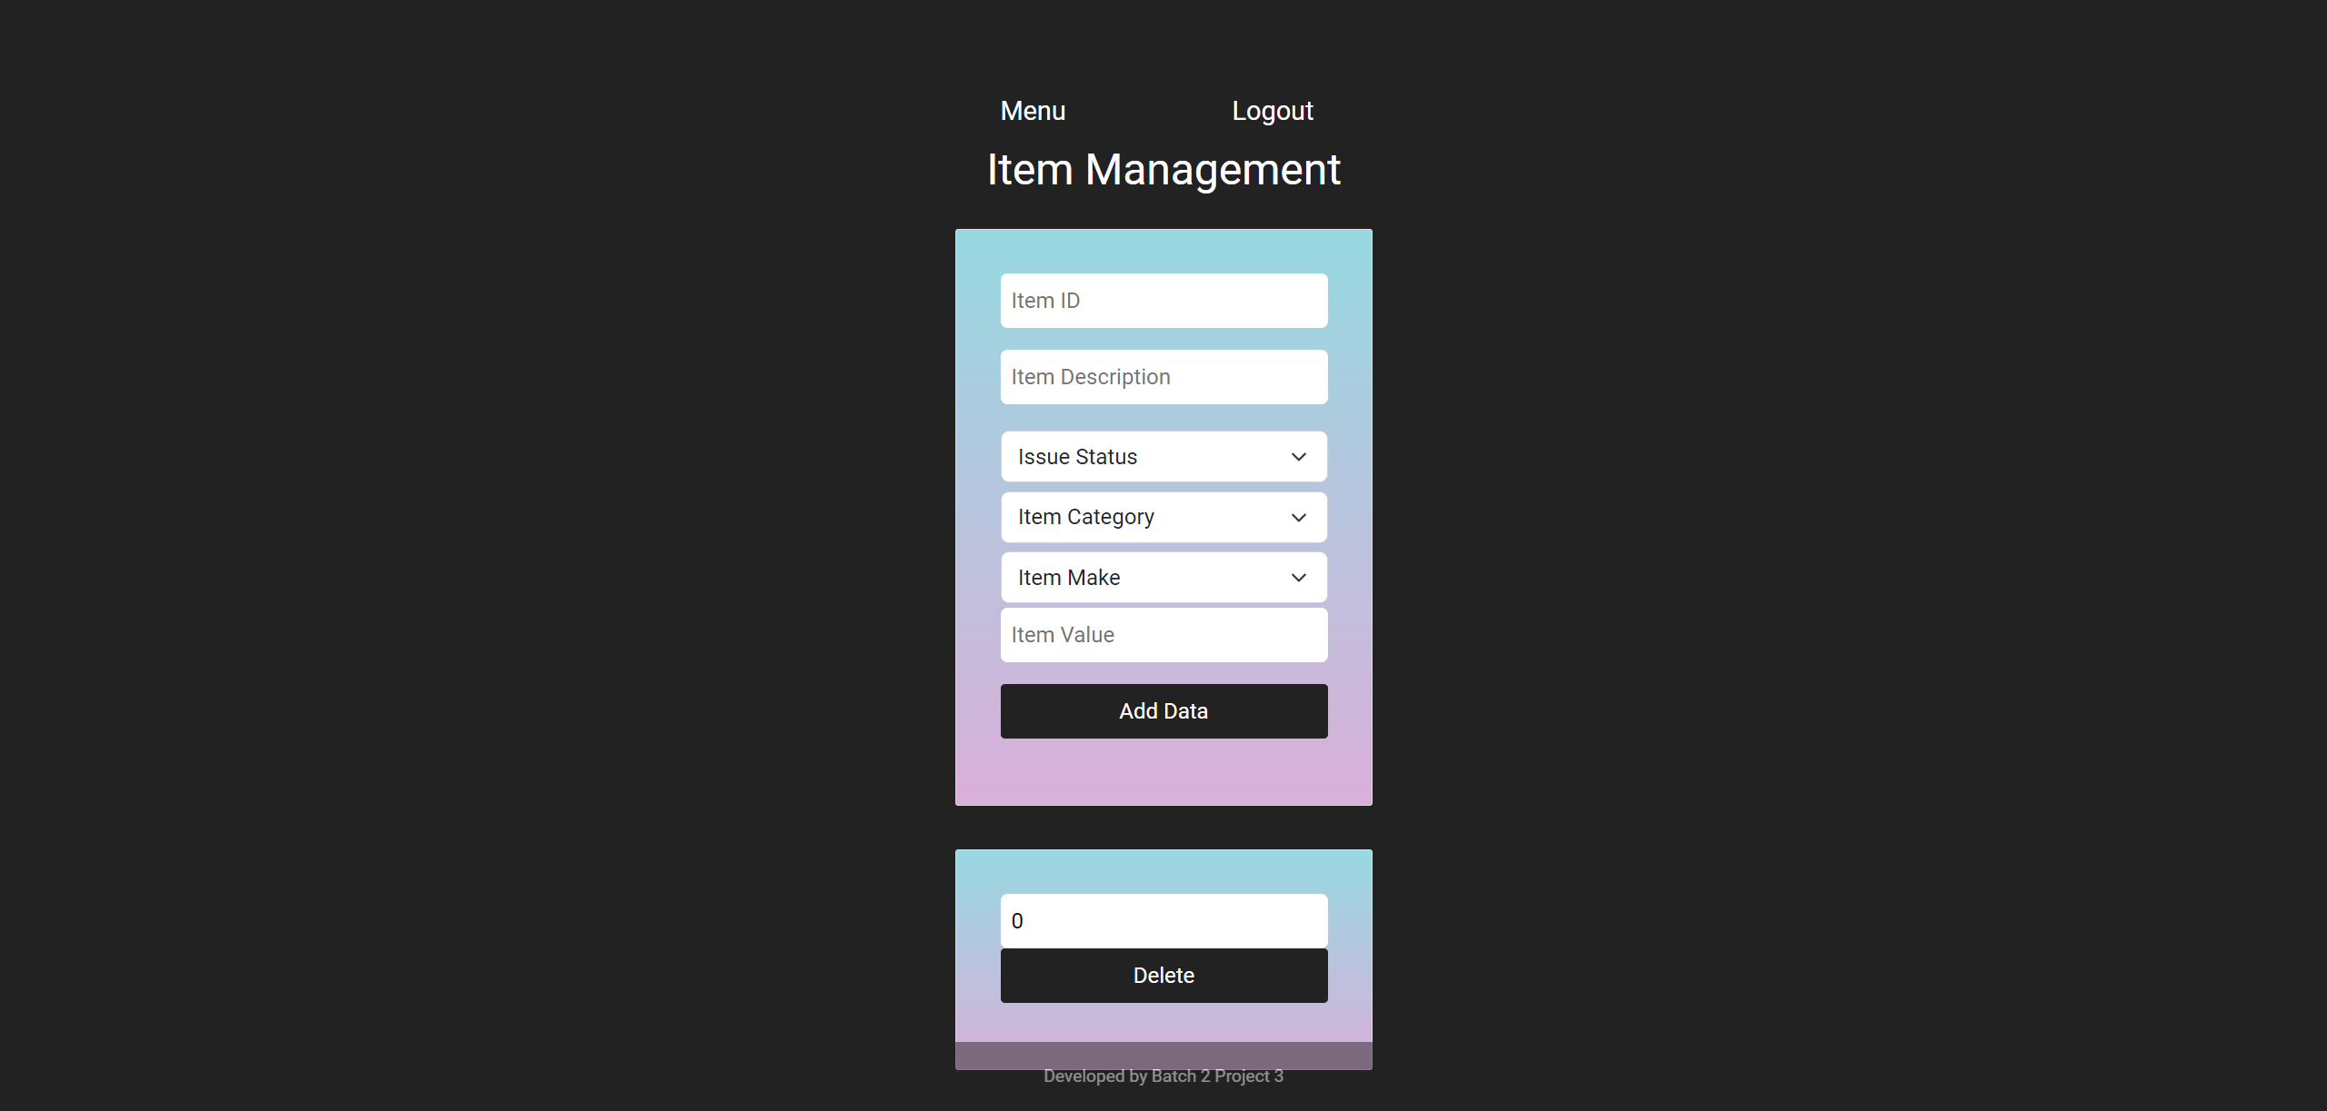
Item Management

